Slide 1


Code Structure
Authors:
Yoav Rozov

Slide 2
Understanding FRC Code Structure
In this presentation, we will explore how our team organizes and structures our FRC robot code using the Command-Based Framework and Java.
This is just one example; every team has its own approach to robot programming. Some teams use similar structure, while others take a completely different path depending on their programming style, robot design and experience.
The goal is to help you understand the overall logic and relationships between the main parts of your Robot Code and give you a ready to use example.

Slide 3
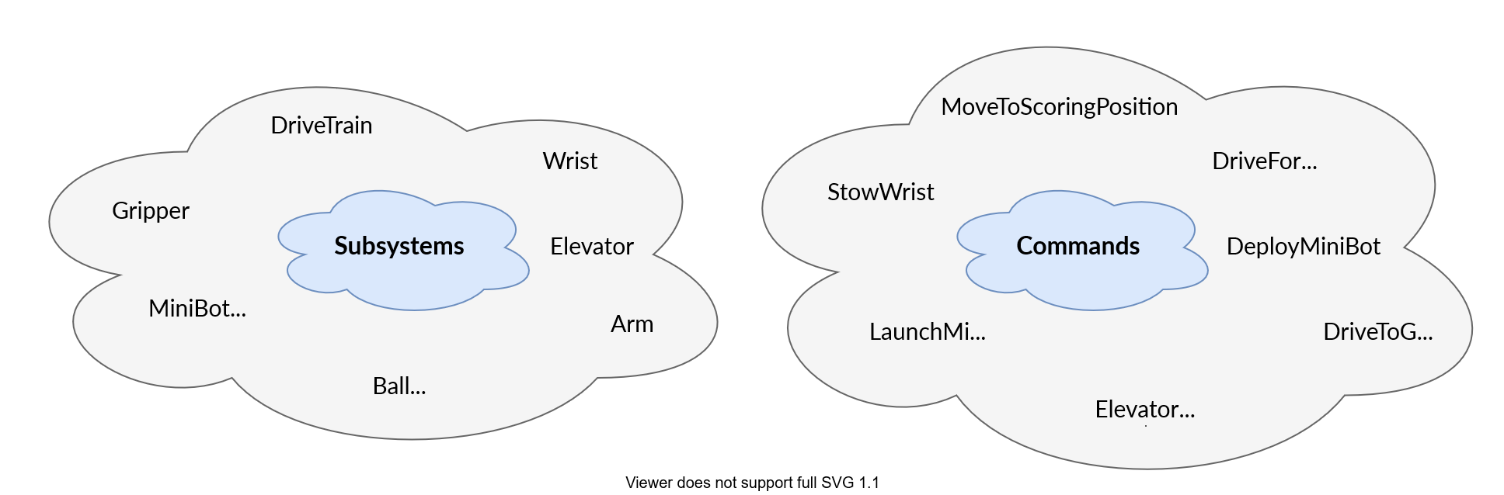
Quick Reminder
Subsystems: The basic building blocks of a robot’s functionality. They represent physical components of the robot (like drive trains, elevators, or intake mechanisms) and provide methods for controlling these components
Commands: Define a high-level actions that involve one or more subsystems. For example, a “DriveDistance” command might use a “DriveTrain” subsystem to drive a certain distance

Slide 4
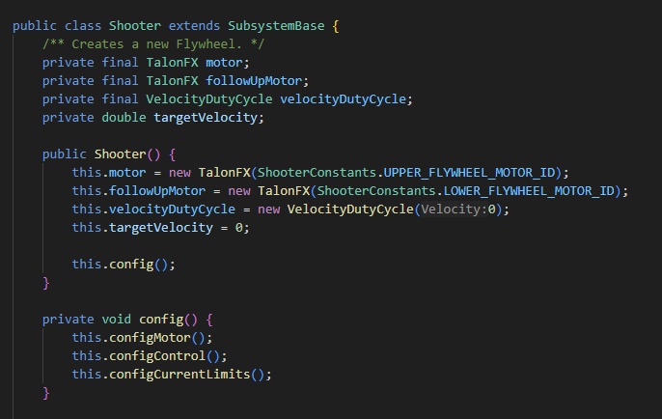
Subsystems
Subsystems should contain the minimum amount of logic necessary to control the physical hardware.
You can think of subsystem methods as the getters and setters of the physical robot system.
The subsystem is responsible for:
Configuring motors, sensors and hardware.
Providing simple control interfaces for commands.
Exposing basic state information
Subsystems should not contain complex robot logic.
Typical functions exposed by a subsystem:
Movement / control:
moveByVelocity()
moveByPercent()
moveByPosition()
moveByAngle()
State getters:
getVelocity()
getPosition()
getAngle()
Target checks:
atTargetVelocity()
atTargetPosition()

Slide 5
Commands
Each subsystem should have one or more commands that perform a simple and general task using that subsystem.
Examples:
MoveShooterByVelocity()
MoveShooterByPercnet()
MoveElevatorByPositon()
A command will typically receive:
The subsystem it controls
A DoubleSupplier that provides the target value (position, velocity, angle…)
Important:
If a command uses a DoubleSupplier the call to the subsystem function should be placed inside the execute() function.
This ensures the value is continuously updated while the command is running.

Slide 6
Group Commands
Group commands combine multiple commands to create more complex robot behaviors.
They allow the robot to perform coordinated actions involving multiple subsystems.
For Example: Shooting a projectile from any distance.
To do this, we might:
Calculate the required shooter velocity based on distance
Run MoveShooterByVelocity with the calculated value
The velocity calculation must come from an external function.
MoveShooterByVelocity(shooter, () -> calculateVelocity(distance))
Where should the complex logic go?
While these functions can be placed inside the group command, it is usually better to place them inside a dedicated static class, such as:
RobotPoseEstimator
RobotStateManager
RobotPhysicsManager
This keeps all complex robot logic centralized and reusable.

Slide 7
Best Practices
Keep subsystems simple
Keep commands focused on one action
Put complex calculations in dedicated logic classes
Add extensive documentation and comments for these functions

Slide 8

Defaults

Slide 9
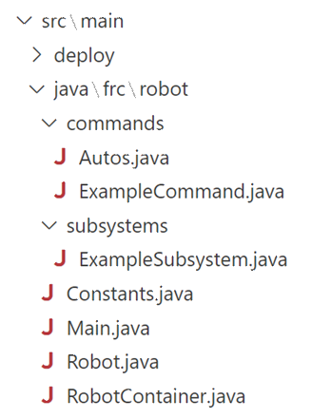
Template defaults
After you create a new Template WPILib project, the default code structure will look something like this
In the next few slides, I will focus on the ‘Robot.java’ & ‘RobotContainer.java’ files.

Slide 10
Robot.java
Purpose
The ‘Robot.java’ class is the main control class that WPILib automatically runs on the robot. It connects the robot’s operating modes (Disabled, Autonomous, Teleop, Test, Simulation) to the rest of the code through the Command Based Framework.
Key Responsibilities
Inherits from TimedRobot, which calls methods at key robot lifecycle moments.
Creates a single instance of RobotContainer
Runs the CommandScheduler every 20ms to:
Check controller inputs
Run and end commands
Update subsystem periodic functions
Starts and stops the selected autonomous command when modes change

Slide 11
RobotContainer.java
Purpose
The ‘RobotContainer.java’ class is where the structure of the robot is defined.
It connects subsystems, commands, and operator controls (with triggers).
Key Responsibilities
Creates all subsystems (e.g., drivetrain, arm, intake)
Creates controller objects (Xbox, joystick, etc.)
Defines button bindings, maps triggers or buttons to commands
Provides the autonomous command that runs during auto mode
Keeps the Robot.java class simple, all robot logic setup happens here

Slide 12
Flow of control
Initialization Process​
‘Robot.java’ initializes ‘RobotContainer’, setting the foundation for all robot operations and configurations
Subsystems and Commands Setup​
‘RobotContainer’ sets up subsystems, commands, and button bindings to manage robot actions effectively
Command Execution Flow​
Button presses trigger commands that interact with subsystems, centralizing robot behavior management
Complexity and Customization​
Increasing robot complexity leads teams to customize architecture for improved clarity and scalability, In the next chapter I will show you some simple changes my team makes to the default template.

Slide 13

Custom structure

Slide 14
Custom classes
After we create a new Template WPILib project we add the following classes:
PorosSubsystems.java – Manage all robot subsystems
RobotTester.java – Manage all debug behavior activated when running “test” mode in DS
ControllersGenerator.java – Manages triggers and default behavior
IDynamicAuto.java – Interface which all Auto commands should implement
DynamicAutoSupplier.java – Object used to store auto commands for a shuffleboard chooser
AutoManager.java – Manages auto and alliance selectors
We also make some changes to the Robot.java and RobotContainer.java classes to incorporate the newly created classes.

Slide 15
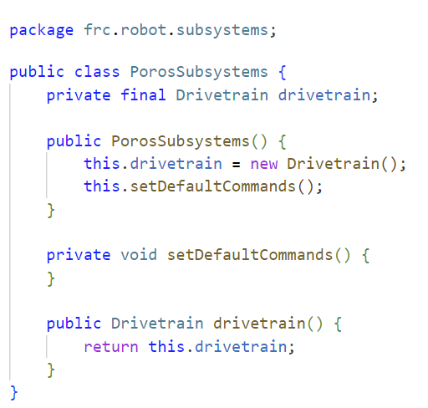
PorosSubsystems.java
Centralized Subsystem Management
PorosSubsystems centralizes initialization and management of all subsystems to improve code structure and readability.
Getter Functions for Access
Provides getter methods allowing commands to easily access subsystems without manual instance passing, reducing duplication.
Simplified Architecture and Maintenance
Encapsulation of subsystem initialization simplifies architecture and improves maintainability of the codebase.
Notes:
The PorosSubsystems class is designed to centralize the management of all subsystems. It initializes each subsystem and provides getter functions for commands to access them. This approach avoids the need to pass subsystem instances around manually, reducing code duplication and improving readability. For example, the drivetrain subsystem is initialized and made accessible through a public method. By encapsulating subsystem initialization, PorosSubsystems simplifies the overall architecture and enhances maintainability.

Slide 16
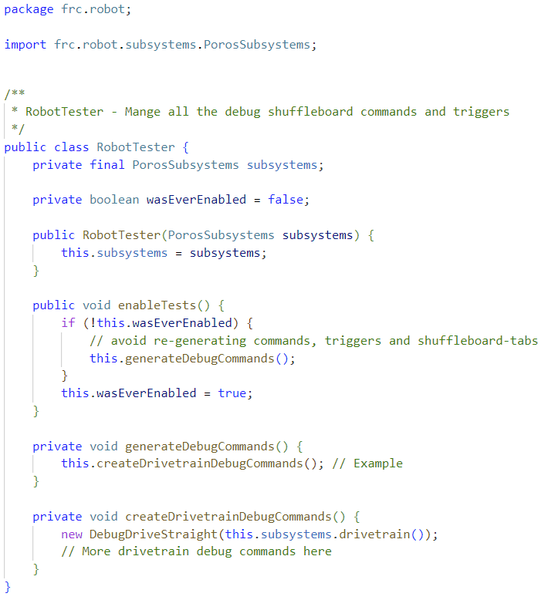
RobotTester.java
Debug Command Initialization
When the “test” mode is enabled through the driver station the RobotTester initializes debug commands for all subsystems (for example the drivetrain subsystem) to assist in targeted testing and troubleshooting.
Efficient Debugging Workflow
RobotTester prevents redundant command generation, ensuring efficient and reliable debugging during development. During competition, the debug commands are not initialized.
Notes:
The RobotTester class manages debug and testing commands. It initializes debug commands when the “test” mode is selected and enabled inside the FRC driver station. The class ensures that debug commands are only generated once, preventing redundant initialization. By encapsulating testing logic, RobotTester facilitates efficient debugging and enhances the reliability of the robot during development and competition.

Slide 17
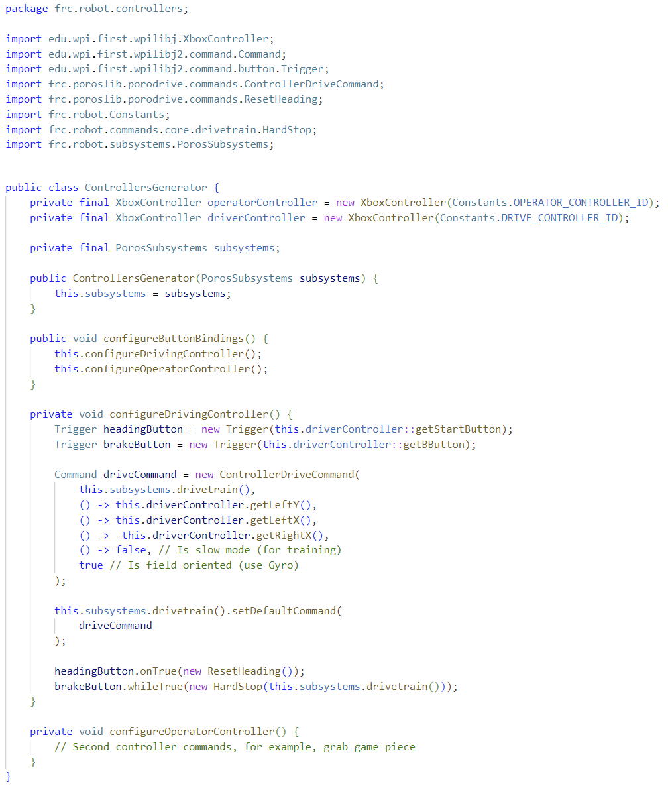
ControllersGenerator.java
Controller Initialization
ControllersGenerator initializes XboxController instances for both driver and operator roles to manage inputs effectively.
Command Bindings
Configure bindings between controller buttons and commands, for example the start and B buttons are bound to commands such as ResetHeading and HardStop to control robot functions.
Default Commands
Configure default commands to specific subsystems, for example the default driving command is set to be ‘ControllerDriveCommand’.
Improved Code Organization
Separating controller logic into ControllersGenerator enhances code maintainability and ease of extension.
Notes:
The ControllersGenerator class is responsible for configuring controller bindings separately from RobotContainer. It initializes XboxController instances for the driver and operator, and sets up triggers to execute commands based on controller input. For example, pressing the start button triggers a ResetHeading command, while holding the B button activates a HardStop command. The class also sets a default drive command using ControllerDriveCommand. By isolating controller logic, ControllersGenerator improves code organization and makes it easier to modify or extend controller behavior without affecting other parts of the codebase.

Slide 18
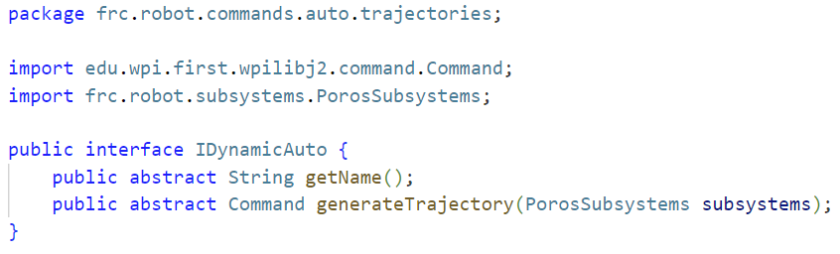
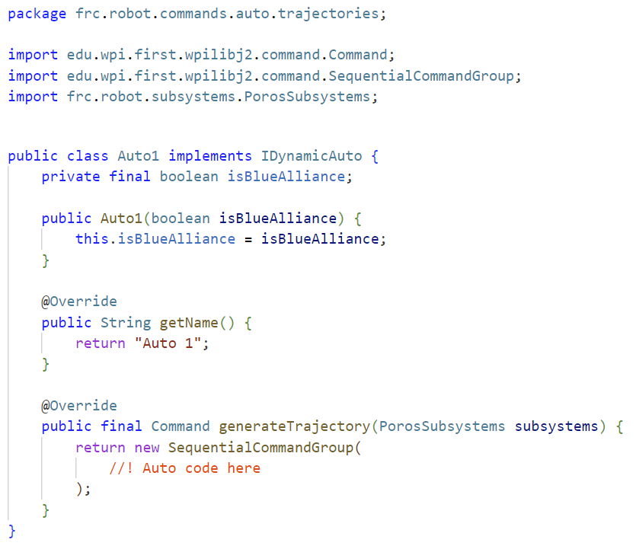
IDynamicAuto.java
Base template
IDynamicAuto provides a base template that all auto commands should follow, every auto command is a sequential command group that is ran during the autonomous period. The name provided inside the “getName” function is what will be displayed inside the shuffleboard selector.

Slide 19
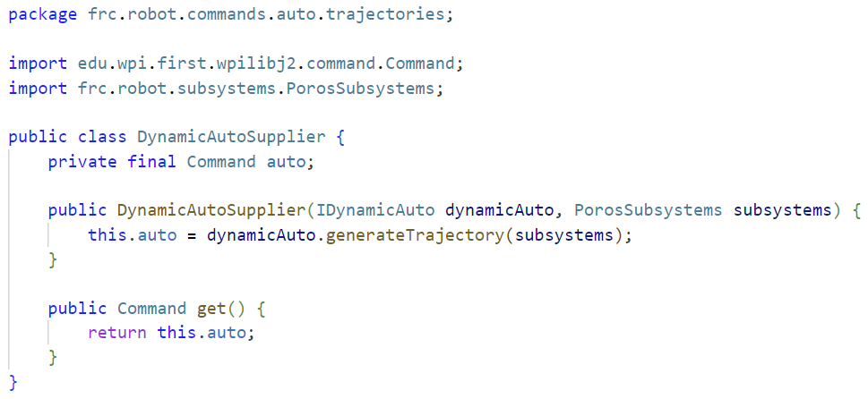
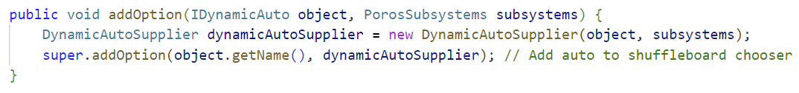
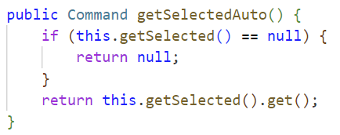
DynamicAutoSupplier.java
Store Object
Provides an easy-to-use class to store different autonomous commands, used inside the ‘AutoManager.java’ class

Slide 20
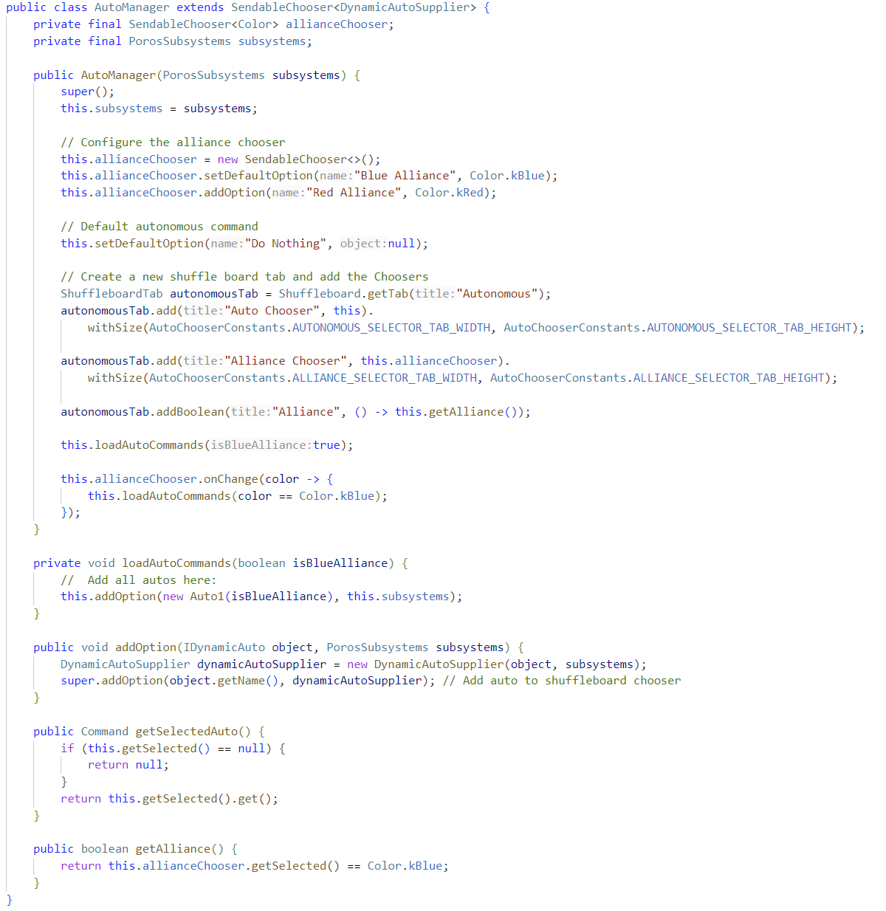
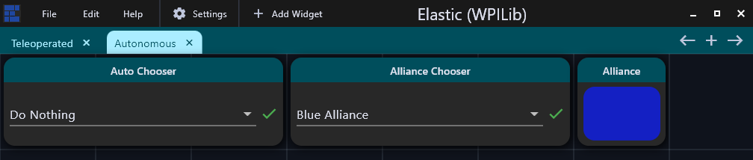
AutoManager.java
Autonomous Command Selection​
AutoManager dynamically selects autonomous commands based on alliance color and match conditions.​
Integration with SendableChooser​
Extends SendableChooser to enable flexible routine selection and updates commands when alliance changes.​
Shuffleboard Publishing​
Publishes chooser elements to Shuffleboard Autonomous tab for easy user interaction and command management.​
Dynamic Autonomous Behavior​
Uses DynamicAutoSupplier to wrap routines and exposes selected command with getSelectedAuto() method.
Notes:
AutoManager handles autonomous command selection and alliance-specific configurations. It extends SendableChooser to allow dynamic selection of autonomous routines based on the selected alliance color. The class publishes chooser elements to the Shuffleboard Autonomous tab and reloads commands when the alliance changes. It wraps autonomous routines using DynamicAutoSupplier and exposes the selected command via getSelectedAuto(). This design provides flexibility and ensures that the robot executes the correct autonomous behavior based on match conditions

Slide 21
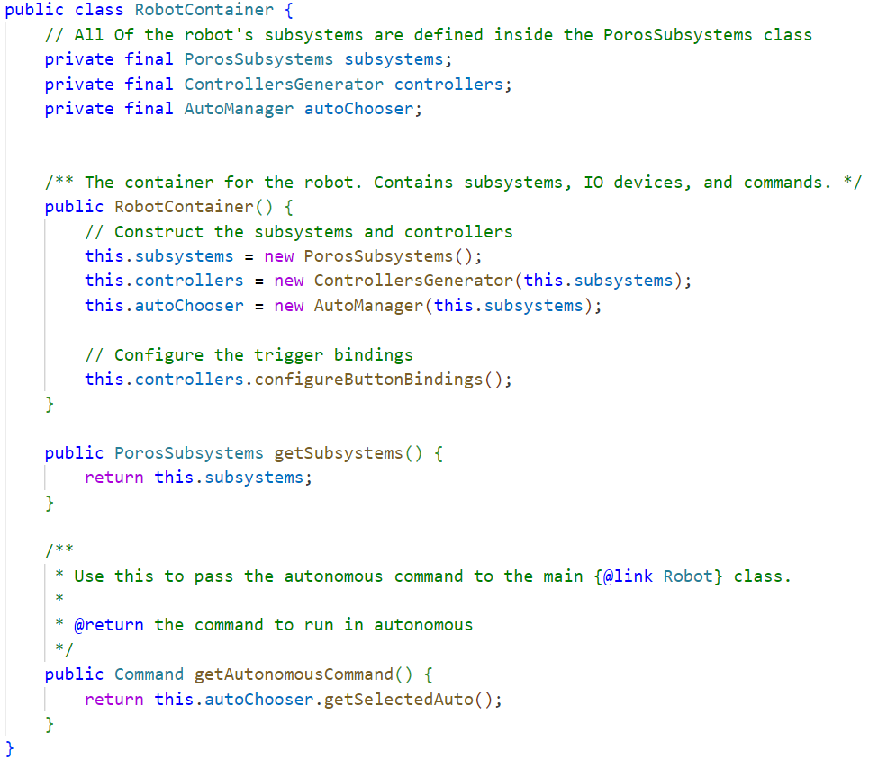
RobotContainer.java - Changes
Most of the logic was moved to our newly created classes, now the Robot Container is much more compact and easier to read:

Slide 22
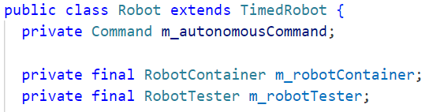
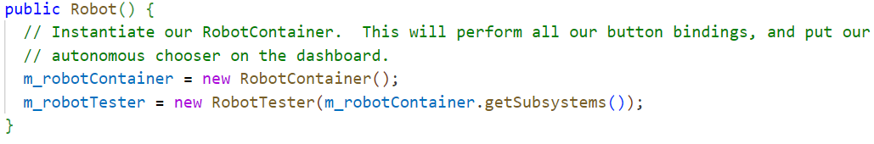
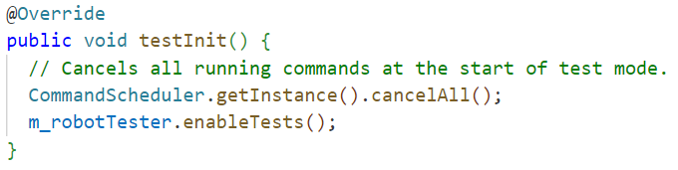
Robot.java - Changes
Initialize the RobotTester
Add the ‘RobotTester’ class at the top of the file and initialize it inside the Robot() constructor along with the ‘RobotContainer’ class.
Enable tests
Add this line to the ‘testInit()’ method to enable all the debug commands that are stored inside the ‘RobotTester’.

Slide 23

Benefits of customization

Slide 24
Advantages of Our Approach
Clear Separation of Concerns
Our approach divides the codebase into distinct parts, improving clarity and ease of maintenance.
Enhanced Debugging and Testing
Introducing dedicated testing classes like ‘RobotTester’ facilitates streamlined debugging and robust testing.
Improved Scalability
The architecture supports adding complex robot behaviors as the system scales up efficiently.
Centralized Maintainability
Centralizing subsystem management and controller bindings enhances maintainability and team collaboration.

